Slide 1
Swing

Slide 2
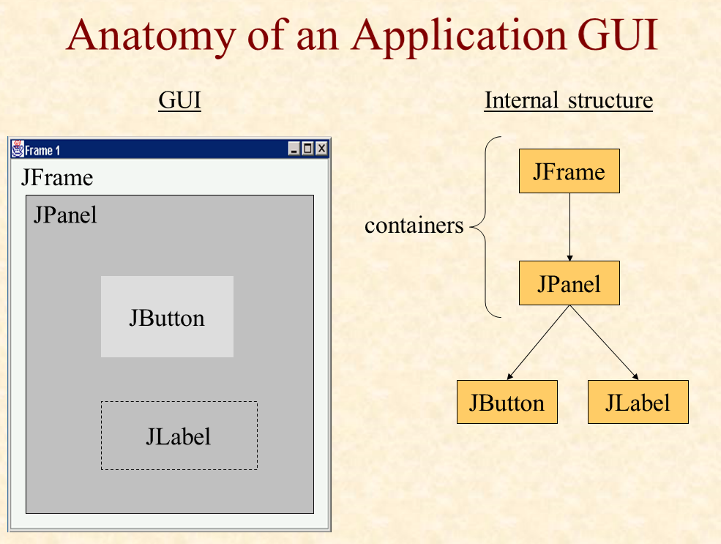

Slide 3
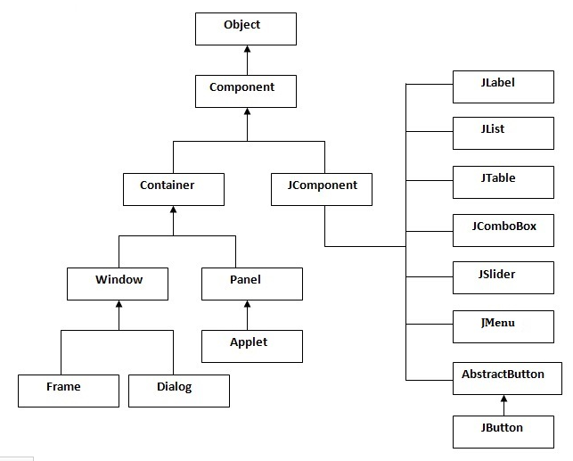
Java swing API

Slide 4
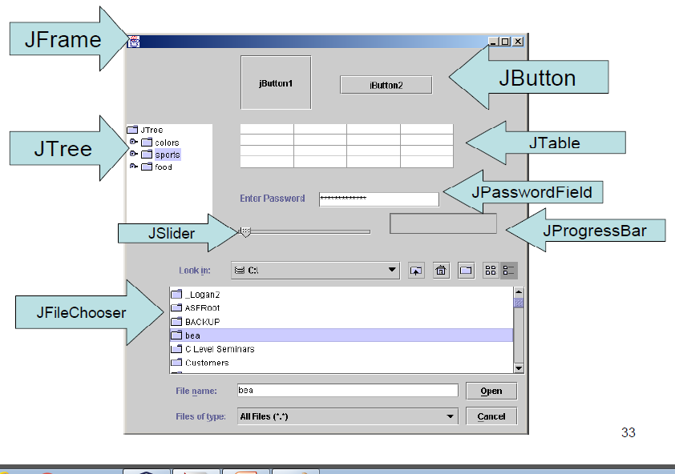

Slide 5
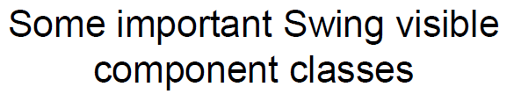
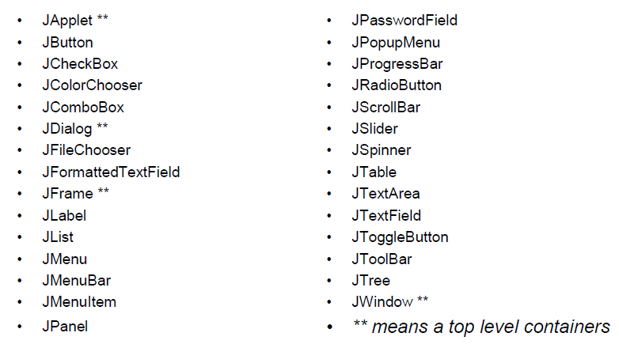

Slide 6
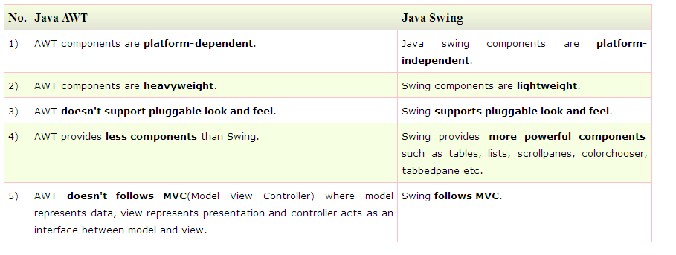

Slide 7
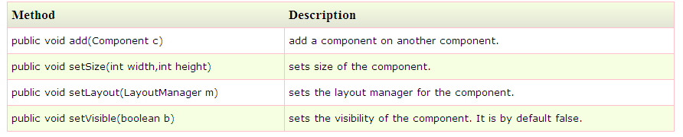

Slide 8
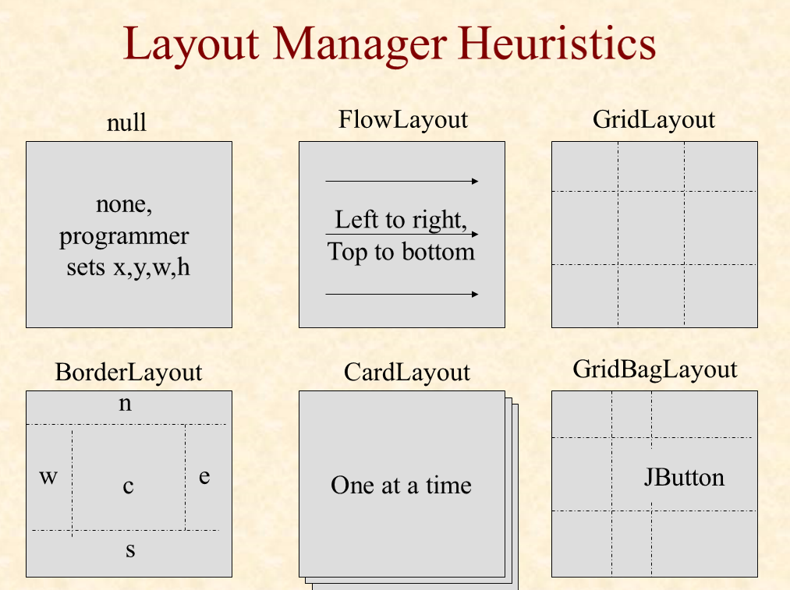

Slide 9
There are two ways to create a frame:
By creating the object of Frame class (association)
By extending Frame class (inheritance)

Slide 10
Example
import javax.swing.*;
public class FirstSwingExample {
public static void main(String[] args) {
JFrame f=new JFrame();//creating instance of JFrame
JButton b=new JButton("click");//creating instance of JButton
b.setBounds(130,100,100, 40);//x axis, y axis, width, height
f.add(b);//adding button in JFrame
f.setSize(400,500);//400 width and 500 height
f.setLayout(null);//using no layout managers
f.setVisible(true);//making the frame visible
}
}

Slide 11
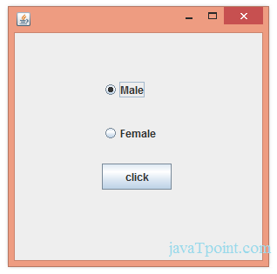
import javax.swing.*;
Class RadioButtonexample{
public static void main(String[] args) {
JFrame f=new JFrame();
JRadioButton r1=new JRadioButton("Male");
JRadioButton r2=new JRadioButton("Female");
r1.setBounds(50,100,70,30);
r2.setBounds(50,150,70,30);
ButtonGroup bg=new ButtonGroup();
bg.add(r1);
bg.add(r2);
f.add(r1);
f.add(r2);
f.setSize(300,300);
f.setLayout(null);
f.setVisible(true);
}
}
}
ButtonGroup class can be used to group multiple buttons so that at a time only one button can be selected.

Slide 12


Slide 13
import javax.swing.*;
import java.awt.event.*;
class RadioExample extends JFrame
implements ActionListener{
JRadioButton rb1,rb2;
JButton b;
RadioExample(){
rb1=new JRadioButton("Male");
rb1.setBounds(100,50,100,30);
rb2=new JRadioButton("Female");
rb2.setBounds(100,100,100,30);
ButtonGroup bg=new ButtonGroup();
bg.add(rb1);
bg.add(rb2);
b=new JButton("click");
b.setBounds(100,150,80,30);
b.addActionListener(this);
add(rb1);add(rb2);add(b);
setSize(300,300);
setLayout(null);
setVisible(true);
}
public void actionPerformed(ActionEvent e)
{
if(rb1.isSelected()){
JOptionPane.showMessageDialog(this,
"You are male");
}
else{
JOptionPane.showMessageDialog(this,"You are female");
}
}
public static void main(String args[]){
new RadioExample();
}}

Slide 14
import javax.swing.*;
import java.awt.event.*;
class RadioExample extends JFrame
implements ActionListener{
JRadioButton rb1,rb2;
JButton b;
public static void main(String args[]){
rb1=new JRadioButton("Male");
rb1.setBounds(100,50,100,30);
rb2=new JRadioButton("Female");
rb2.setBounds(100,100,100,30);
ButtonGroup bg=new ButtonGroup();
bg.add(rb1);
bg.add(rb2);
b=new JButton("click");
b.setBounds(100,150,80,30);
b.addActionListener(this);
add(rb1);add(rb2);add(b);
setSize(300,300);
setLayout(null);
setVisible(true);
}
public void actionPerformed(ActionEvent e)
{
if(rb1.isSelected()){
JOptionPane.showMessageDialog(this,
"You are male");
}
else{
JOptionPane.showMessageDialog(this,"You are female");
}
}
}}

Slide 15
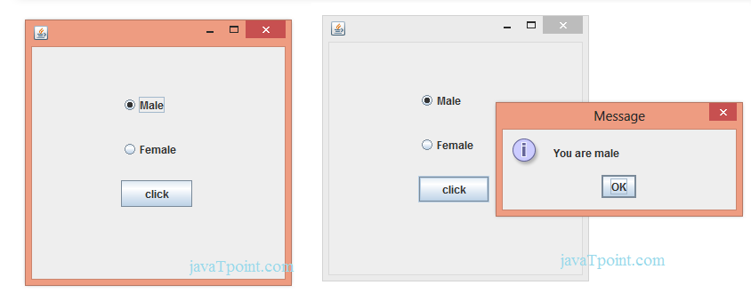

Slide 16
Commonly used Constructors:
JTextArea(): creates a text area that displays no text initially.
JTextArea(String s): creates a text area that displays specified text initially.
JTextArea(int row, int column): creates a text area with the specified number of rows and columns that displays no text initially..
JTextArea(String s, int row, int column): creates a text area with the specified number of rows and columns that displays specified text.

Slide 17
Commonly used methods of JTextArea class:
1)public void setRows(int rows): is used to set specified number of rows.
2) public void setColumns(int cols):: is used to set specified number of columns.
3) public void setFont(Font f): is used to set the specified font.
4) public void insert(String s, int position): is used to insert the specified text on the specified position.
5) public void append(String s): is used to append the given text to the end of the document.

Slide 18
import java.awt.Color;
import javax.swing.*;
Class AREA1{
public static void main(String[] args) {
JFrame f=new JFrame();
JTextArea area=new JTextArea(300,300);
area.setBounds(10,30,300,300);
area.setBackground(Color.black);
area.setForeground(Color.white);
f.add(area);
f.setSize(400,400);
f.setLayout(null);
f.setVisible(true);
} }

Slide 19
import java.awt.Color;
import javax.swing.*;
Class AREA1 extends JFrame{
public static void main(String[] args) {
JTextArea area=new JTextArea(300,300);
area.setBounds(10,30,300,300);
area.setBackground(Color.black);
area.setForeground(Color.white);
add(area);
setSize(400,400);
setLayout(null);
setVisible(true);
} }

Slide 20
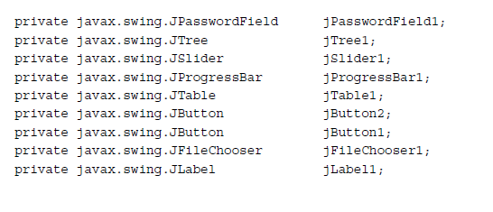

Slide 21
Commonly used methods of JComboBox class:
1) public void addItem(Object anObject): is used to add an item to the item list.
2) public void removeItem(Object anObject): is used to delete an item to the item list.
3) public void removeAllItems(): is used to remove all the items from the list.
4) public void setEditable(boolean b): is used to determine whether the JComboBox is editable.
5) public void addActionListener(ActionListener a): is used to add the ActionListener.
6) public void addItemListener(ItemListener i): is used to add the ItemListener.

Slide 22
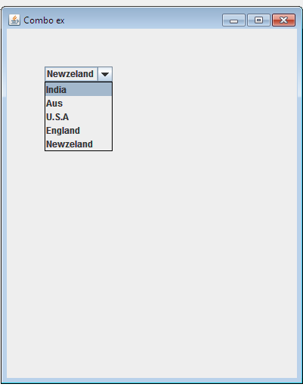

Slide 23
import javax.swing.*;
public class Combo {
public static void main(String[] args) {
JFrame f=new JFrame("Combo ex");
String country[]={"India","Aus","U.S.A","England","Newzeland"};
JComboBox cb=new JComboBox(country);
cb.setBounds(50, 50,90,20);
f.add(cb);
f.setLayout(null);
f.setSize(400,500);
f.setVisible(true);
}
}

Slide 24
Commonly used Constructors of JTable class:
JTable(): creates a table with empty cells.
JTable(Object[][] rows, Object[] columns): creates a table with the specified data.

Slide 25
import javax.swing.*;
public class MyTable {
public static void main(String[] args) {
JFrame f=new JFrame();
String data[][]={ {"101","Amit","670000"},
{"102","Jai","780000"},
{"101","Sachin","700000"}};
String column[]={"ID","NAME","SALARY"};
JTable jt=new JTable(data,column);
jt.setBounds(30,40,200,300);
JScrollPane sp=new JScrollPane(jt);
f.add(sp);
f.setSize(300,400);
// f.setLayout(null);
f.setVisible(true);
}
}

Slide 26
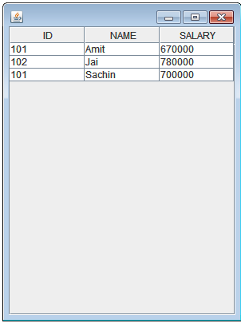

Slide 27
slider
Constructor | Description
JSlider() | creates a slider with the initial value of 50 and range of 0 to 100.
JSlider(int orientation) | creates a slider with the specified orientation set by either JSlider.HORIZONTAL or JSlider.VERTICAL with the range 0 to 100 and initial value 50.
JSlider(int min, int max) | creates a horizontal slider using the given min and max.
JSlider(int min, int max, int value) | creates a horizontal slider using the given min, max and value.
JSlider(int orientation, int min, int max, int value) | creates a slider using the given orientation, min, max and value.

Slide 28
Method | Description
public void setMinorTickSpacing(int n) | is used to set the minor tick spacing to the slider.
public void setMajorTickSpacing(int n) | is used to set the major tick spacing to the slider.
public void setPaintTicks(boolean b) | is used to determine whether tick marks are painted.
public void setPaintLabels(boolean b) | is used to determine whether labels are painted.
public void setPaintTracks(boolean b) | is used to determine whether track is painted.

Slide 29
import javax.swing.*;
public class SliderExample extends JFrame{
public static void main(String s[]) {
JSlider slider = new JSlider(JSlider.HORIZONTAL, 0, 50, 25);
slider.setMinorTickSpacing(2);
slider.setMajorTickSpacing(10);
slider.setPaintTicks(true);
slider.setPaintLabels(true);
JPanel panel=new JPanel();
panel.add(slider);
add(panel);
setVisible(true);
}
}

Slide 30
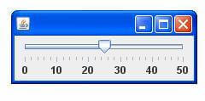

Slide 31
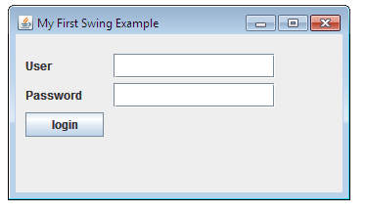

Slide 32
import javax.swing.*
public class SwingFirstExample {
public static void main(String[] args) {
JFrame frame = new JFrame("My First Swing Example");
frame.setSize(350, 200);
JPanel panel = new JPanel();
frame.add(panel);
panel.setLayout(null);
JLabel userLabel = new JLabel("User");
userLabel.setBounds(10,20,80,25);
panel.add(userLabel);
JTextField userText = new JTextField( 20);
userText.setBounds(100,20,165,25);
panel.add(userText);
JLabel passwordLabel = new JLabel("Password");
passwordLabel.setBounds(10,50,80,25);
panel.add(passwordLabel);
JPasswordField passwordText = new JPasswordField(20);
passwordText.setBounds(100,50,165,25);
panel.add(passwordText);
JButton loginButton = new JButton("login");
loginButton.setBounds(10, 80, 80, 25);
panel.add(loginButton);
frame.setVisible(true);
}
}
}

Slide 33
Constructor | Description
JTree() | Creates a JTree with a sample model.
JTree(Object[] value) | Creates a JTree with every element of the specified array as the child of a new root node.
JTree(TreeNode root) | Creates a JTree with the specified TreeNode as its root, which displays the root node.

Slide 34
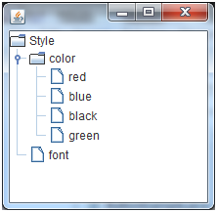

Slide 35
import javax.swing.*;
import javax.swing.tree.DefaultMutableTreeNode;
public class TreeExample {
JFrame f=new JFrame();
public static void main(String[] args) {
DefaultMutableTreeNode style=new DefaultMutableTreeNode("Style");
DefaultMutableTreeNode color=new DefaultMutableTreeNode("color");
DefaultMutableTreeNode font=new DefaultMutableTreeNode("font");
style.add(color);
style.add(font);
DefaultMutableTreeNode red=new DefaultMutableTreeNode("red");
DefaultMutableTreeNode blue=new DefaultMutableTreeNode("blue");
DefaultMutableTreeNode black=new DefaultMutableTreeNode("black");
DefaultMutableTreeNode green=new DefaultMutableTreeNode("green");
color.add(red);
color.add(blue);
color.add(black);
color.add(green);
JTree jt=new JTree(style);
f.add(jt);
f.setSize(200,200);
f.setVisible(true);
}

Slide 36
Constructor | Description
JTabbedPane() | Creates an empty TabbedPane with a default tab placement of JTabbedPane.Top.
JTabbedPane(int tabPlacement) | Creates an empty TabbedPane with a specified tab placement.
JTabbedPane(int tabPlacement, int tabLayoutPolicy) | Creates an empty TabbedPane with a specified tab placement and tab layout policy.

Slide 37
import javax.swing.*;
public class TabbedPaneExample {
JFrame f=new JFrame();
public static void main(String[] args) {
JTextArea ta=new JTextArea(200,200);
JPanel p1=new JPanel();
p1.add(ta);
JPanel p2=new JPanel();
JPanel p3=new JPanel();
JTabbedPane tp=new JTabbedPane();
tp.setBounds(50,50,200,200);
tp.add("main",p1);
tp.add("visit",p2);
tp.add("help",p3);
f.add(tp);
f.setSize(400,400);
f.setLayout(null);
f.setVisible(true);
} }

Slide 38
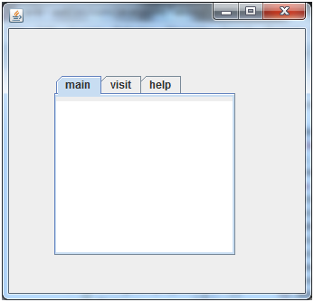

Slide 39
Constructor | Description
JList() | Creates a JList with an empty, read-only, model.
JList(ary[] listData) | Creates a JList that displays the elements in the specified array.
JList(ListModel<ary> dataModel) | Creates a JList that displays elements from the specified, non-null, model.

Slide 40
Methods | Description
Void addListSelectionListener(ListSelectionListener listener) | It is used to add a listener to the list, to be notified each time a change to the selection occurs.
int getSelectedIndex() | It is used to return the smallest selected cell index.
ListModel getModel() | It is used to return the data model that holds a list of items displayed by the JList component.
void setListData(Object[] listData) | It is used to create a read-only ListModel from an array of objects.

Slide 41
import javax.swing.*;
public class ListExample
{
JFrame f= new JFrame();
public static void main(String args[])
{
DefaultListModel<String> l1 = new DefaultListModel<>();
l1.addElement("Item1");
l1.addElement("Item2");
l1.addElement("Item3");
l1.addElement("Item4");
JList<String> list = new JList<>(l1);
list.setBounds(100,100, 75,75);
f.add(list);
f.setSize(400,400);
f.setLayout(null);
f.setVisible(true);
}

Slide 42
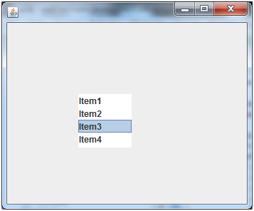

Slide 43
Syntax
JLabel label = new JLabel("SUBJECT ");
label.setIcon(new ImageIcon("E:\\new.png"));
JTextArea text = new JTextArea();
text.setText("Add subject here...");

Slide 44
package my;
import java.awt.GridBagLayout;
import javax.swing.*
import javax.swing.WindowConstants;
public class SwingDemo {
public static void main(String[] args) {
JFrame frame = new JFrame("Demo Frame");
JPanel panel = new JPanel();
JLabel label = new JLabel("SUBJECT ");
label.setIcon(new ImageIcon("E:\\new.png"));
JTextArea text = new JTextArea();
text.setText("Add subject here...");
panel.setLayout(new GridBagLayout());
panel.add(label);
panel.add(text);
panel.setBorder(BorderFactory.createEmptyBorder(10, 10, 10, 10));
frame.setDefaultCloseOperation(WindowConstants.EXIT_ON_CLOSE);
frame.add(panel);
frame.setSize(500, 300);
frame.setVisible(true);
}
}

Slide 45
setDefaultCloseOperation(javax.swing.WindowConstants.EXIT_ON_CLOSE);

Slide 46
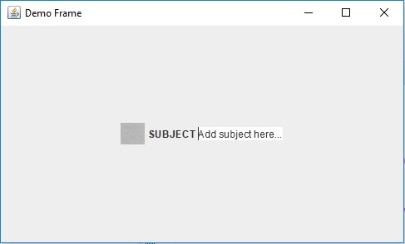

Slide 47
Thank you

Slide 48
Model–view–controller (MVC)
Model–view–controller (MVC) is a software architectural pattern for implementing user interfaces on computers.
it divides a given software application into three interconnected parts, so as to separate internal representations of information from the ways that information is presented to or accepted from the user.

Slide 49
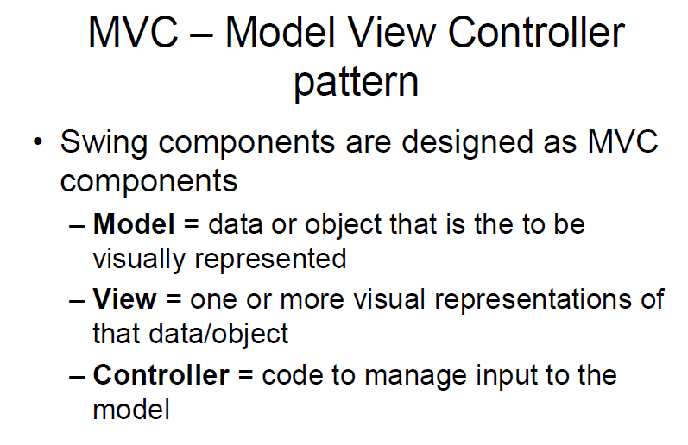

Slide 50
